Slide 1
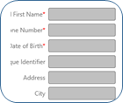
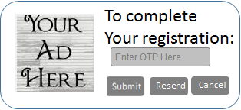

End User Registration
Secure Trading System
Detail User Information
End User Verification
Service
MAC OTP System
End
User
Enrolment
1
STS End User Registration
Service
Request(Register)
Response(Registered / Failed)
2
Request OTP
Service
Request(Request OTP)
Response(Request Id, Ad Info / Error)
3
Request(Verify OTP)
Response(Validated / Invalid)
Verify OTP
Service

Slide 2
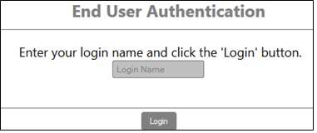
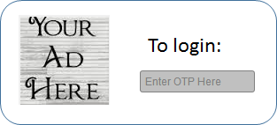

End User Authentication
Secure Trading System
MAC OTP System
Request(Request OTP)
Response(Request Id, Ad div)
Request OTP
Service
End
User
Login
Request(Verify OTP)
Response(Validated, Ad Text/Invalid)
Verify OTP
Service
Welcome

Slide 3
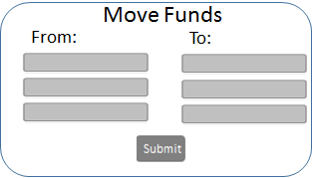
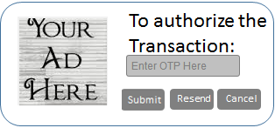
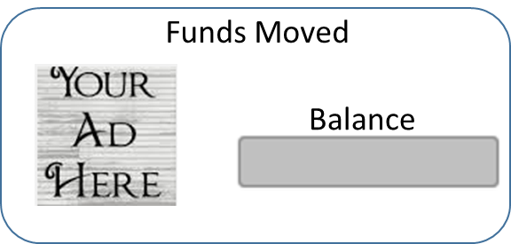
Transaction Authorization / Verification
(Funds Movement)
Secure Trading System
Note: Request contains a different transaction type and transaction details
Request(RequestOTP)
Response(Request Id, Ad Text)
Request OTP
Service
Funds
Movement
Request(Verify OTP)
Response(Validated/Invalid, , Ad Info)
Verify OTP
Service

